Slide 1
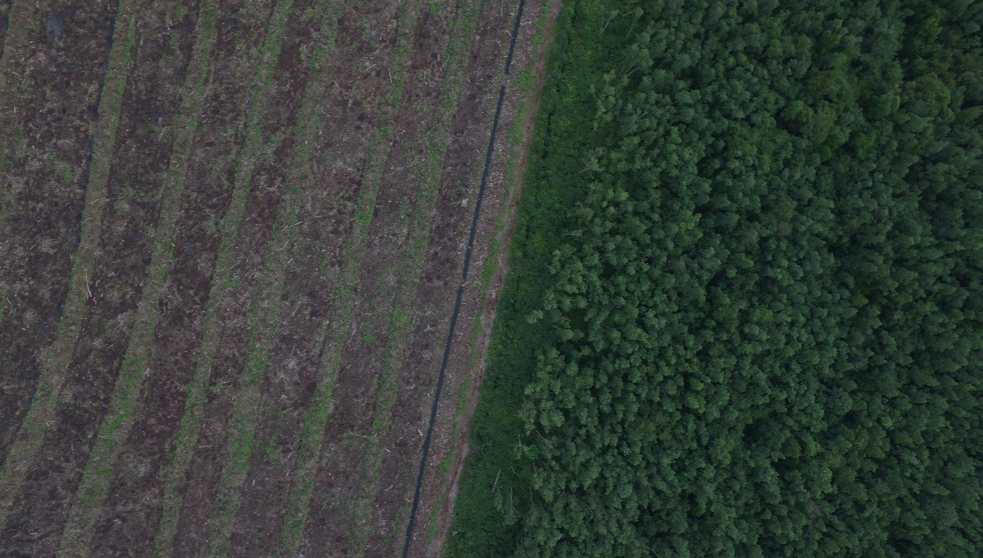


An Introduction to machine learning with Random Forests
D. T. Milodowski
School of GeoSciences & National Centre for Earth Observation, University of Edinburgh
Notes:
Hello, and thank you for the opportunity to speak today.
I’m David Milodowski, and I’m going to present results from some of the work we’ve been doing in Sabah, using airborne LiDAR surveys to quantify the structural impact of logging on forest canopies.
This research forms part of the NERC-funded BALI project, which aims to better understand how biodiversity and biogeochemical cycles are impacted by degradation

Slide 2
Why use machine learning?
Life is complicated!
We like to analyse complex things and make predictions:
classification, regression etc.
Often have a lot of data that capture this complexity
Often don’t have all the data we’d like
Machine learning algorithms have potential to fit complex models, often with high predictive accuracy

Slide 3
Cautionary Notes
Lots of options – no one algorithm is the best in all circumstances
Results are only as good as the data you provide
Algorithms can be complex – a black box – and subject to method-specific limitations
The results are sometimes nonsense (e.g. “personalised” adverts)

Slide 4
Random forests
classification & regression – essentially the same underlying algorithm
Relatively simple to understand & implement
Can fit complex non-linear relationships and interactions
Useful additional information e.g. relative importance of dependent variables

Slide 5
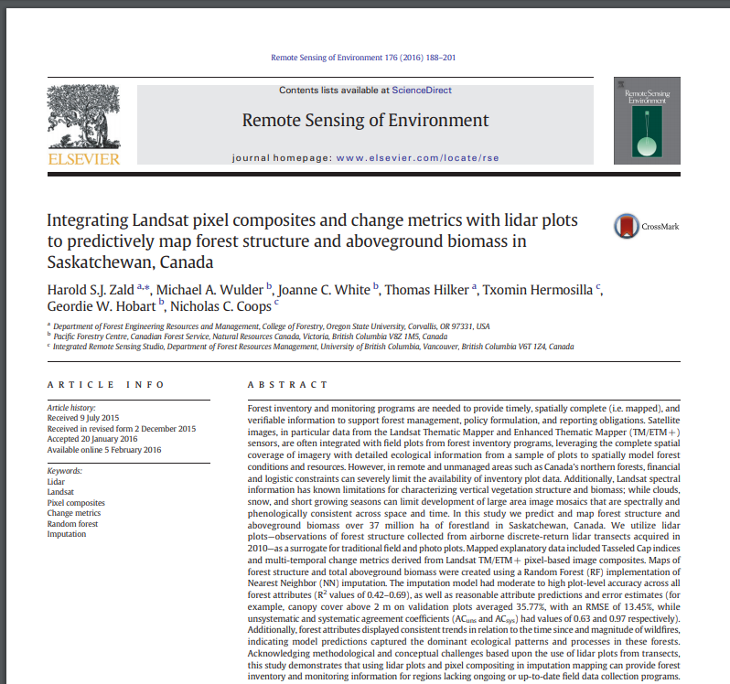
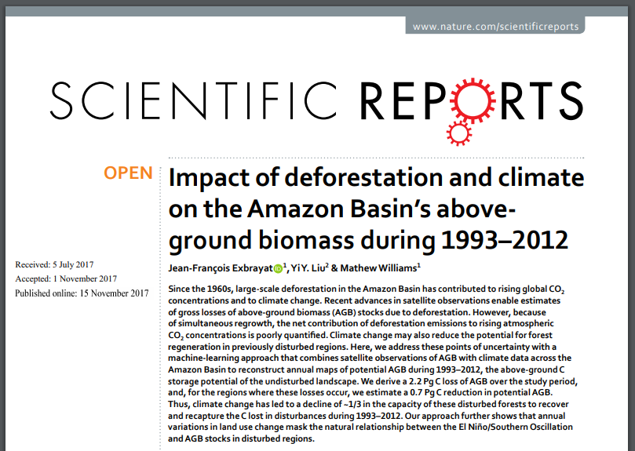
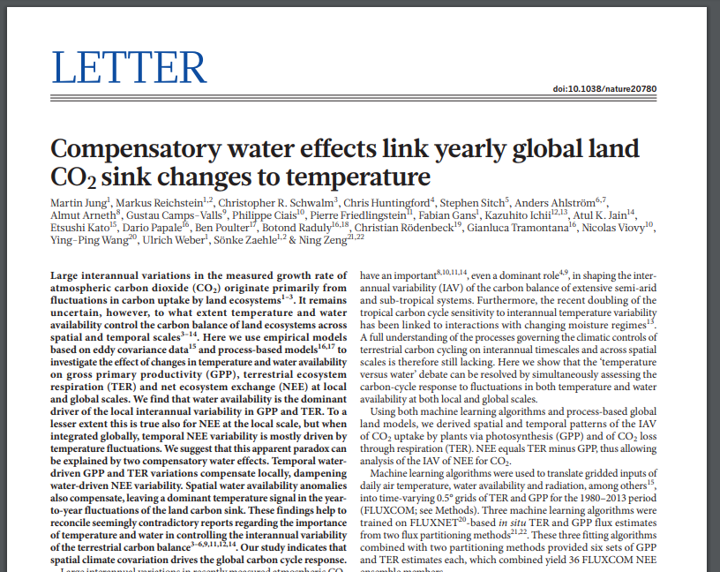
Lots of uses!
Analysing complex multivariate relationships (e.g climate-land-use-carbon) dependencies
Upscaling from small-scale LiDAR surveys to regional maps of biomass
Extrapolation from point flux tower observation network to global maps of energy and carbon fluxes (FLUXCOM)

Slide 6
How do Random Forests work?
A simple introduction (honest)

Slide 7
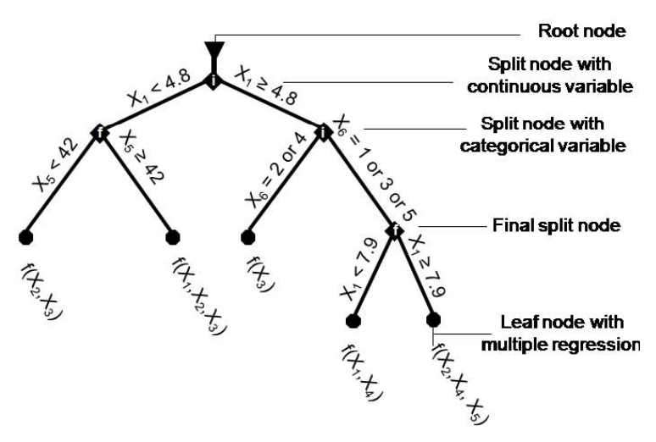
A “forest” of Decision Trees
Randomly sample training data (with replacement)
A random subset of variables (<= total number of variables)
Construct decision tree:
At each node, predictor variable providing best split is used to part the data into two groups
Continue until the data has been split as far as specified/as far as possible
Jung et al., Biogeosciences, 2009

Slide 8
Random forest == Multiple of (random) trees
Averaging across many decision trees provides increases accuracy and stability of predictions
For classification, class probabilities calculated from class fraction at leaf node
For regression, estimated values calculated from mean at leaf node
Variable importance determined by height within each tree
Jung et al., Biogeosciences, 2009

Slide 9
Cautionary Notes 2
Flexible and easy to use, but not perfect!
Only as good as your data
Behaves differently to parametric regression models
Cannot extrapolate
Struggles to interpolate across holes in parameter space (may not always be desired though)
Overfitting!
Under-prediction of extremes/tendency towards the mean
Can be difficult to decipher the functional effect of particular variables

Slide 10
Scikit-learn – machine learning with python
Many different machine learning algorithms available
Built in functions for splitting data, cross validation, hyper-parameter sensitivity testing etc.
Key hyper-parameters in RF implementation:
number of trees in forest (n_estimators)
max number of variables considered for splitting a node (max_features)
max number of levels in decision tree (max_depth)
min data required before node is split (min_samples_split)
min data allowed within a given leaf node (min_samples_leaf)

Slide 11
Example
Simple RF regression
Cal/val
Variable importance
Partial dependencies

